Slide 1
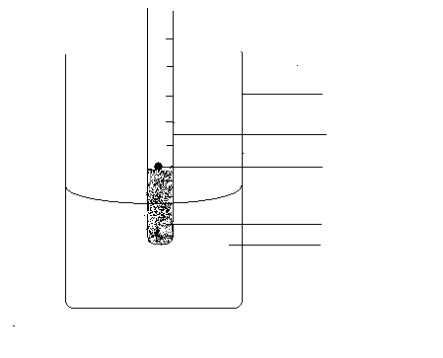
Beaker
Test tube
weight
sand
water

